Slide 1
06 Jun Meeting

Slide 2
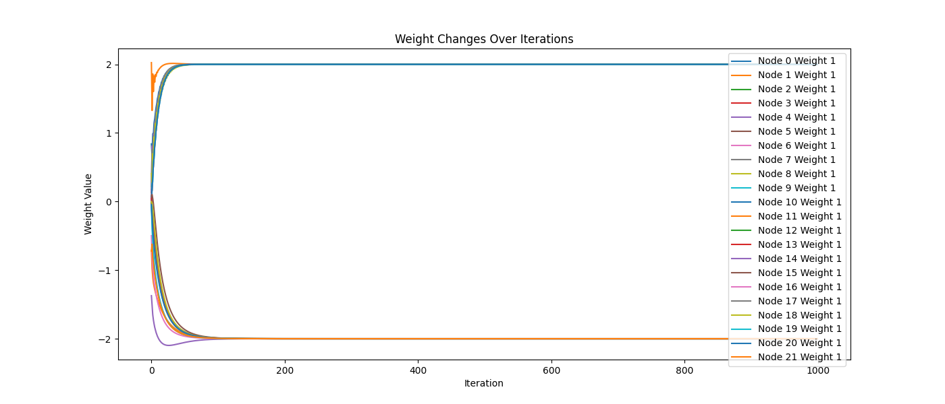
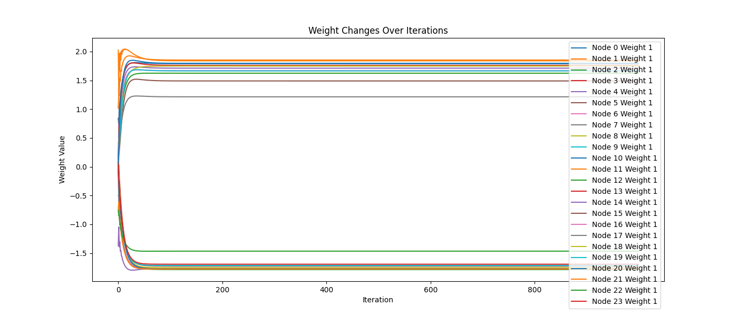
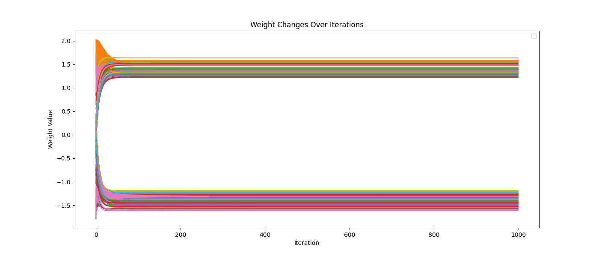
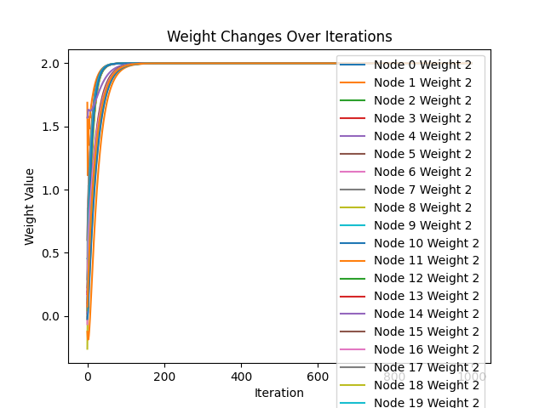
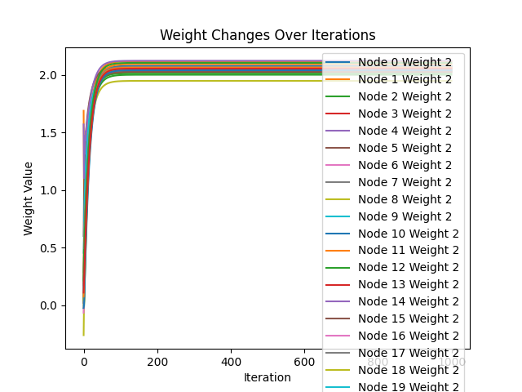
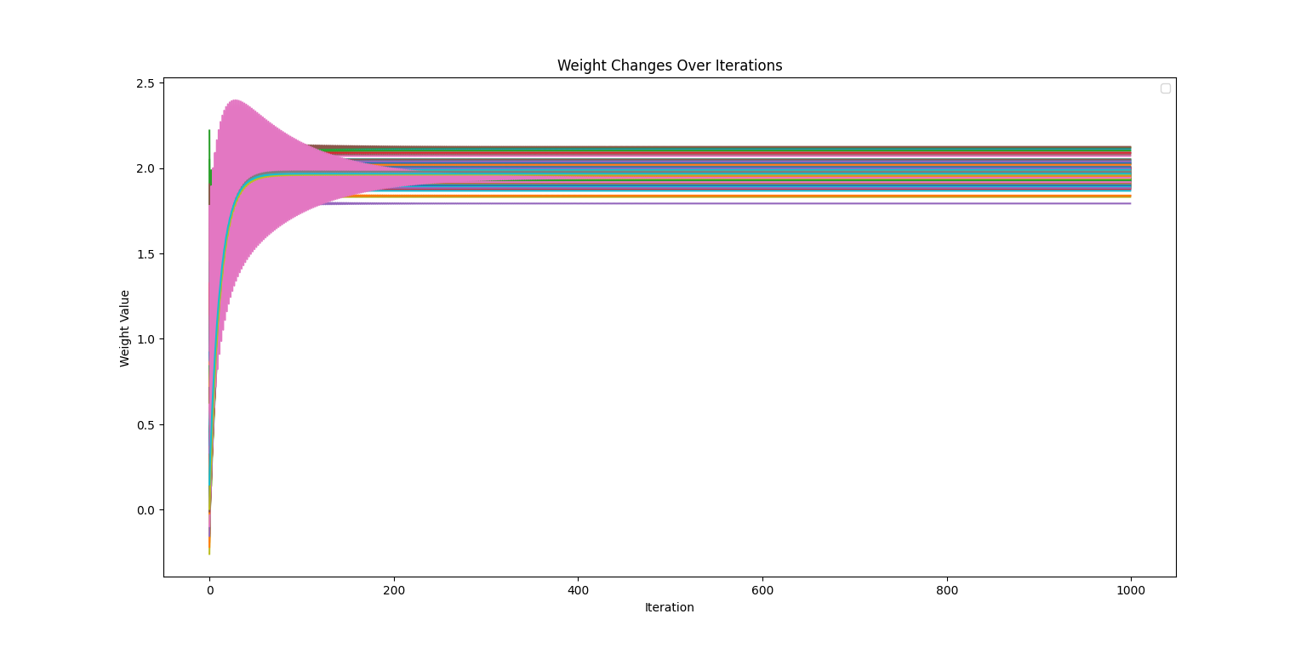
History Weight Curve
11 nodes
12 nodes
100 nodes

Slide 3
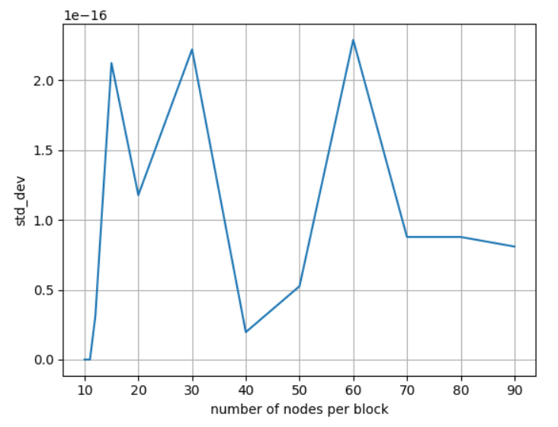
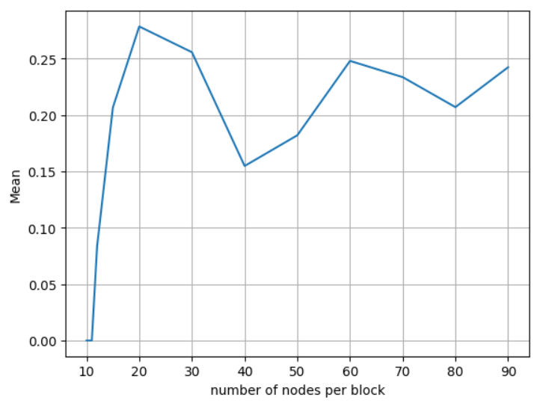
Mean and Std_dev Curve
Mean
Std_dev

Slide 4
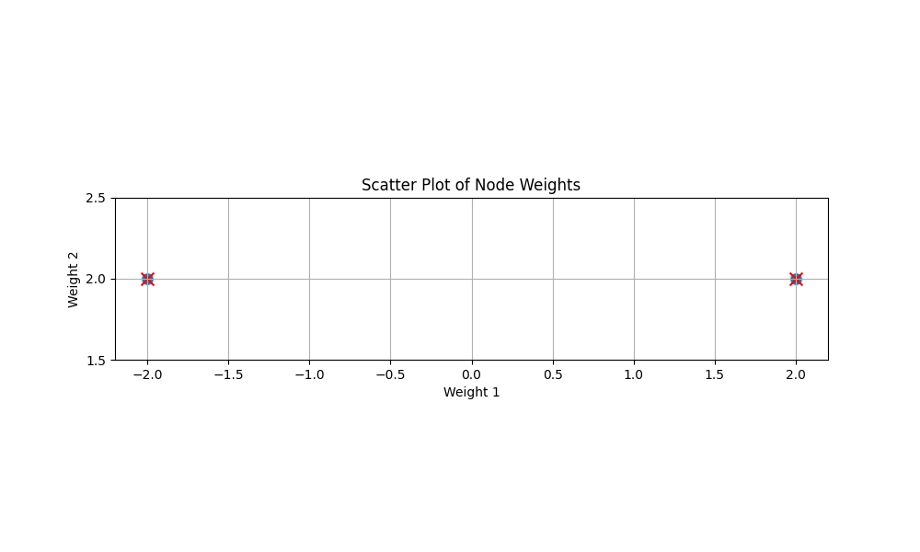
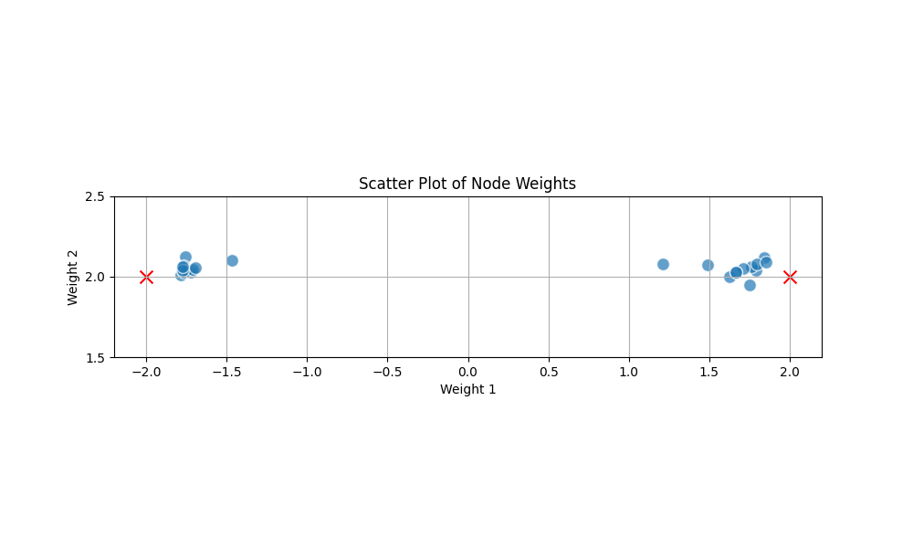
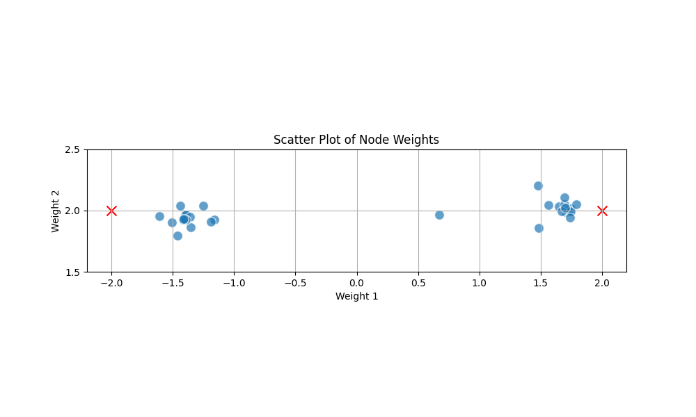
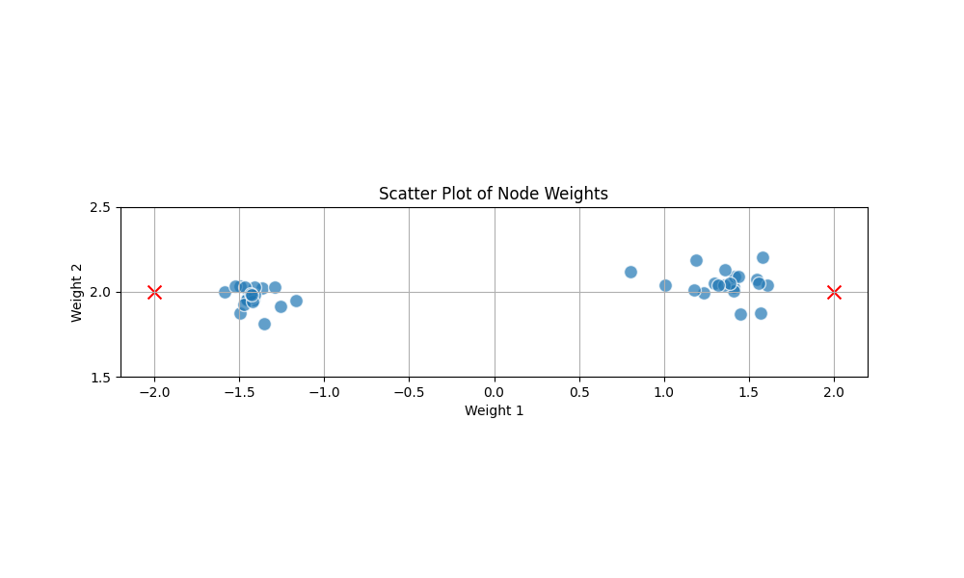
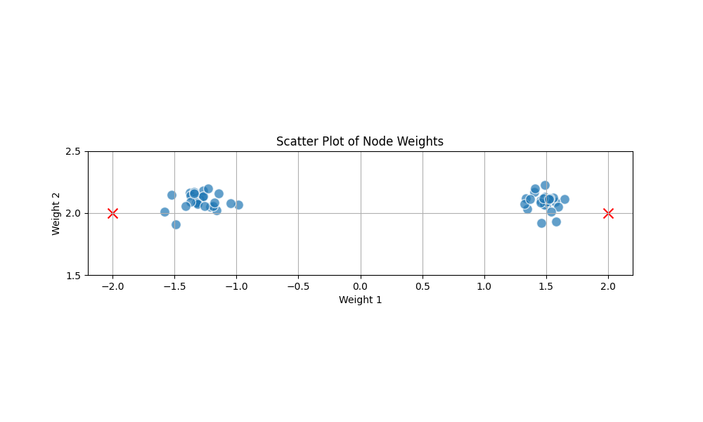
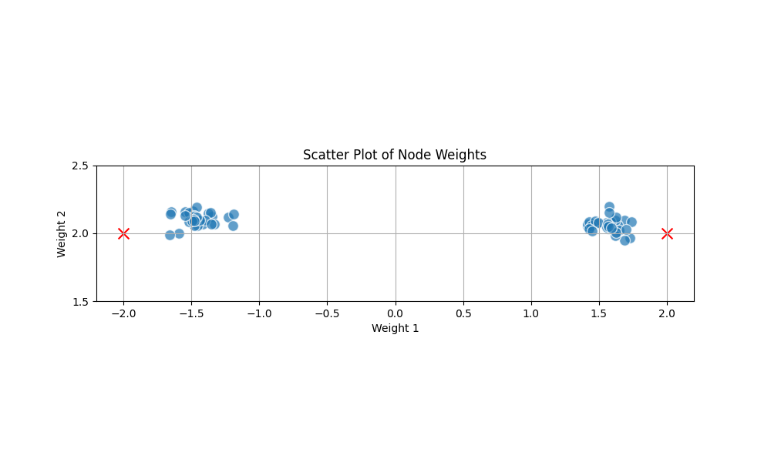
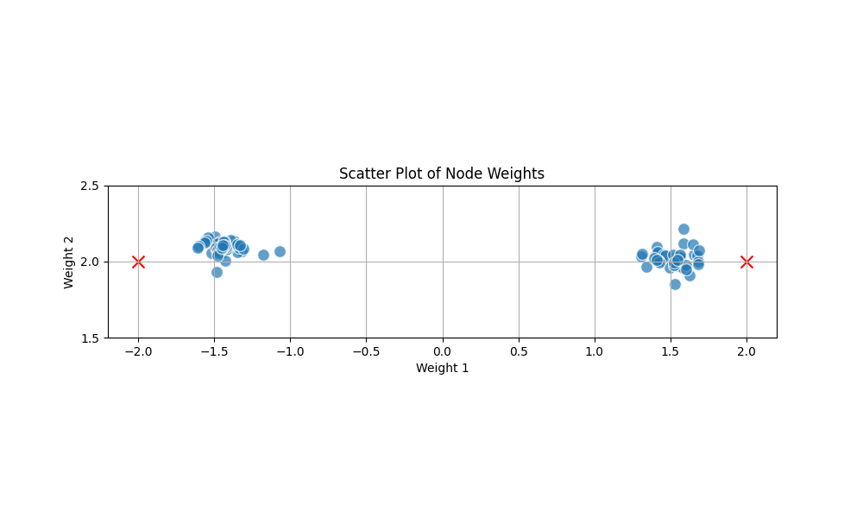
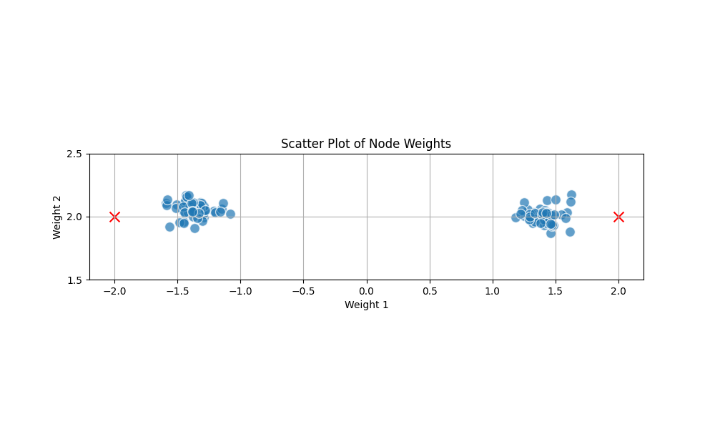
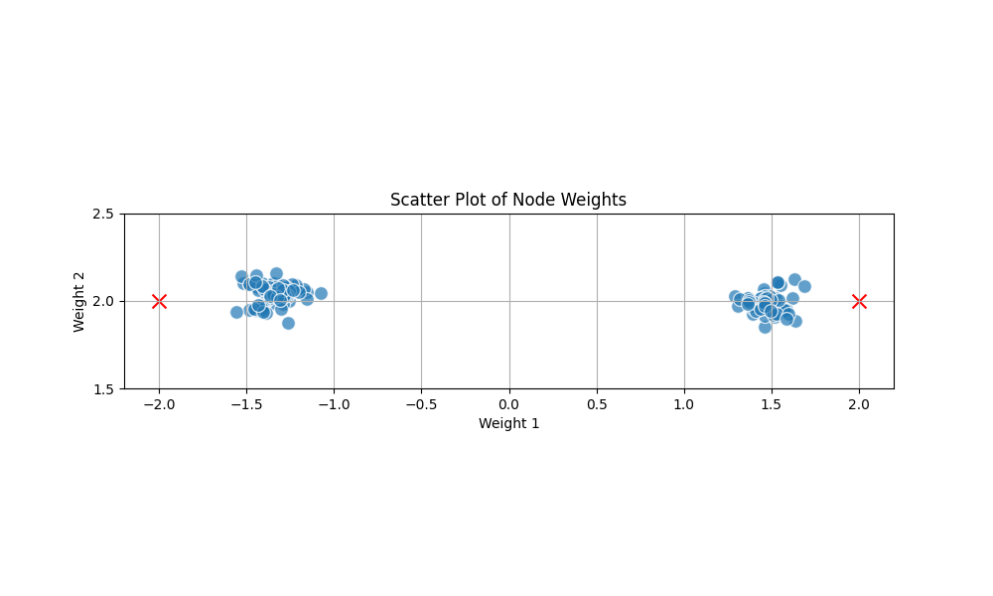
Weight Scatter
11 nodes
12 nodes
15 nodes
20 nodes
30 nodes
40 nodes
50 nodes
60 nodes
70 nodes

Slide 5
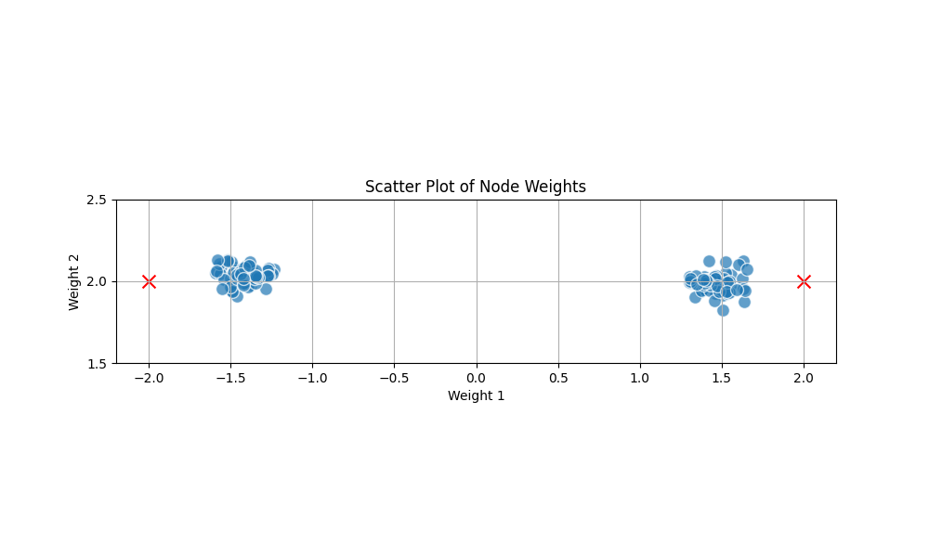
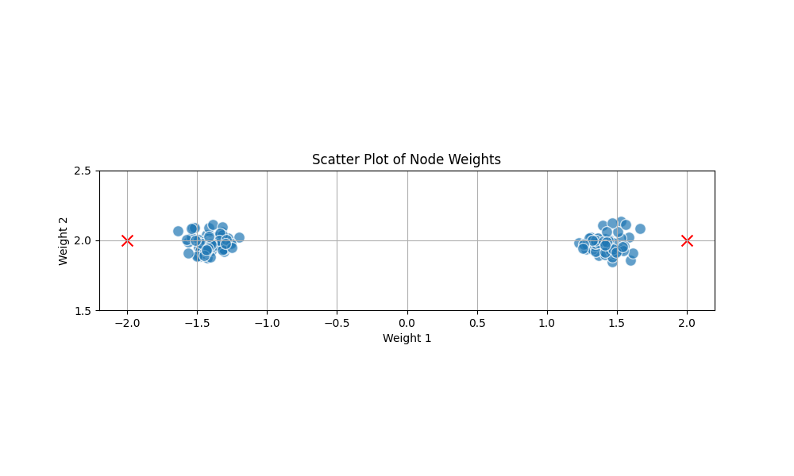
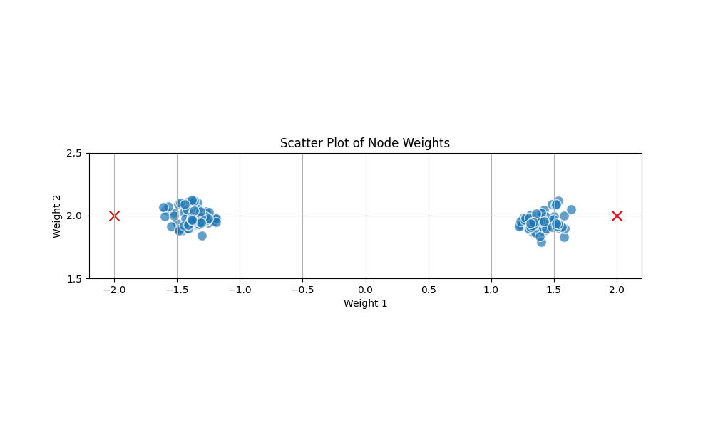
Weight Scatter
80 nodes
90 nodes
100 nodes

Slide 6
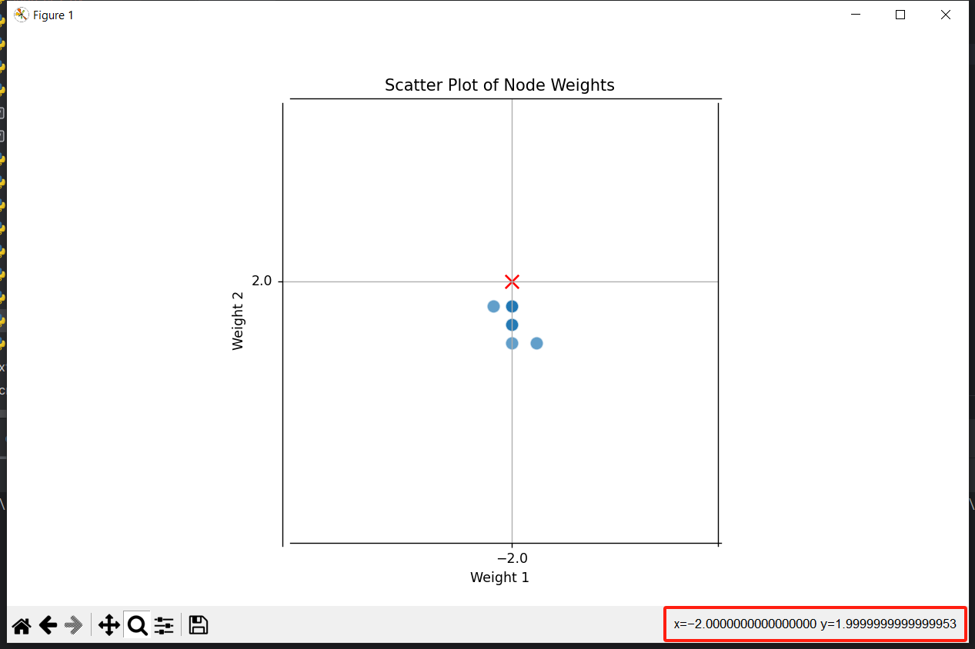
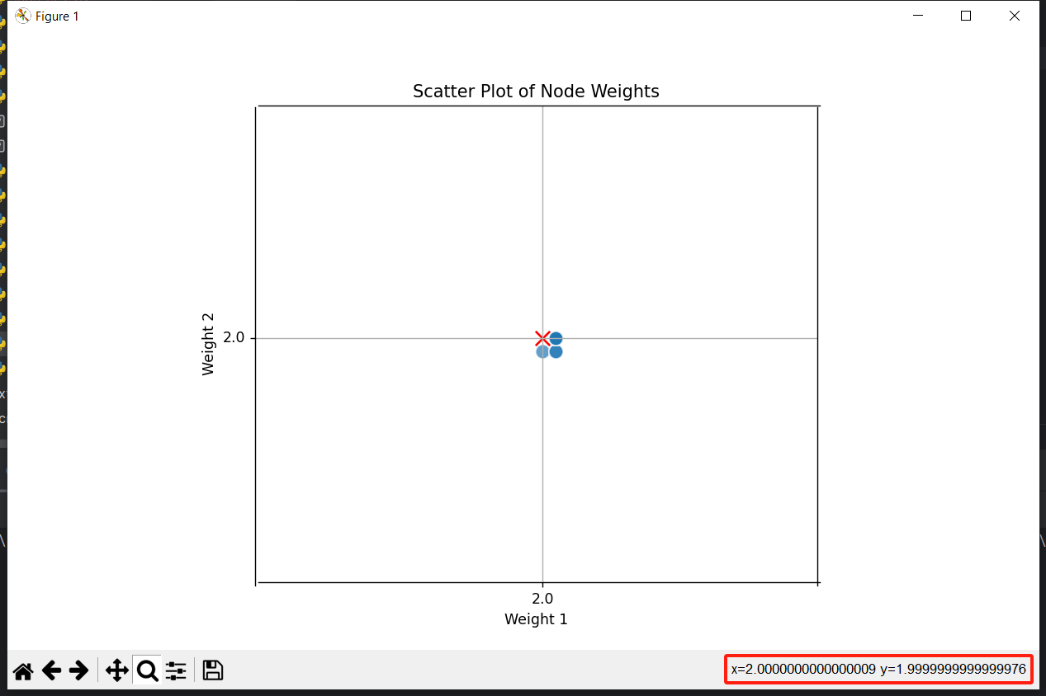
Weight Scatter 11 Nodes

Slide 7
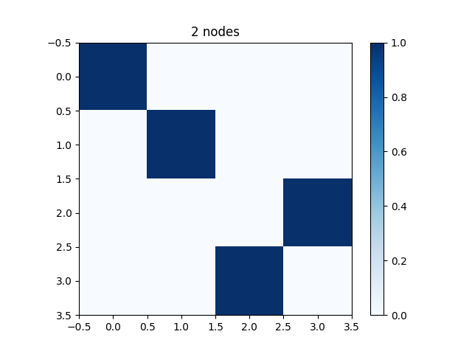
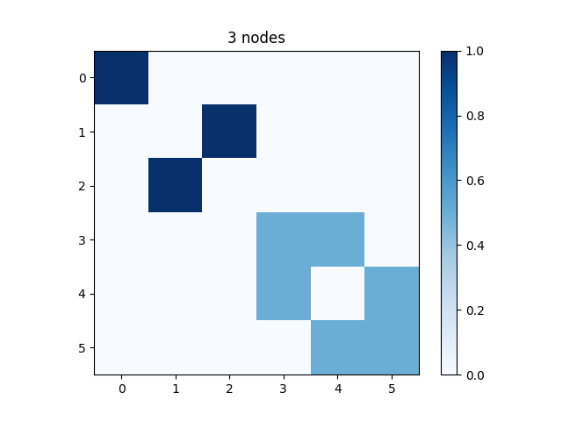
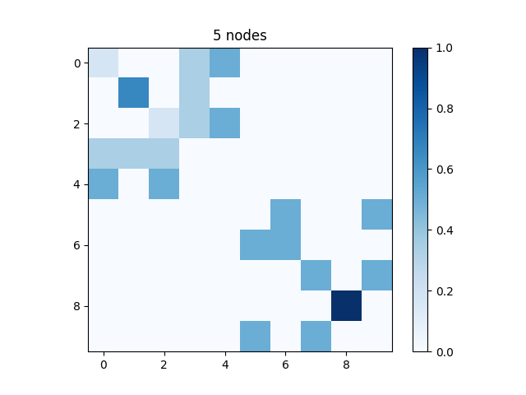
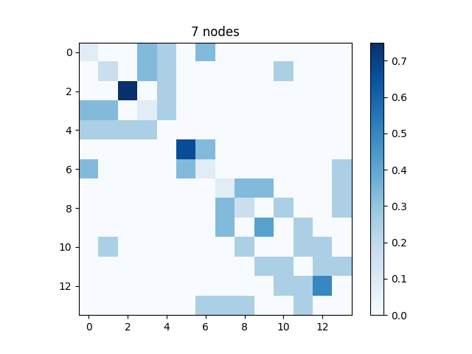
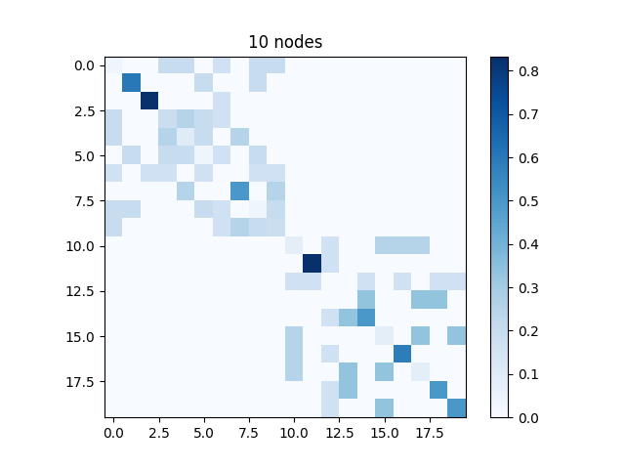
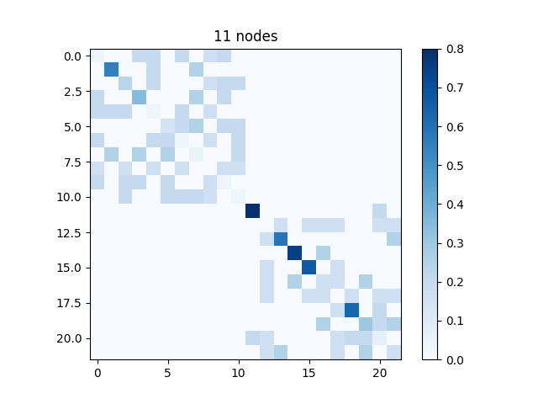
Heatmap of Adjacent Matrix
divergent

Slide 8
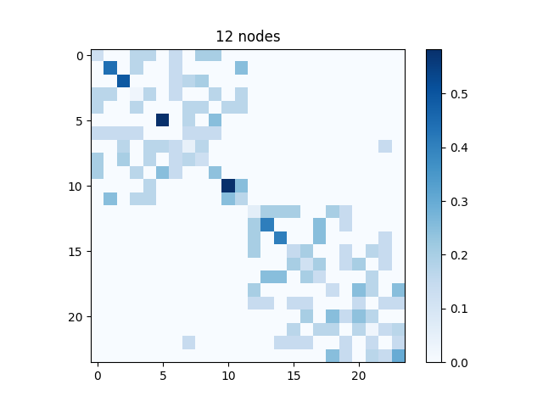
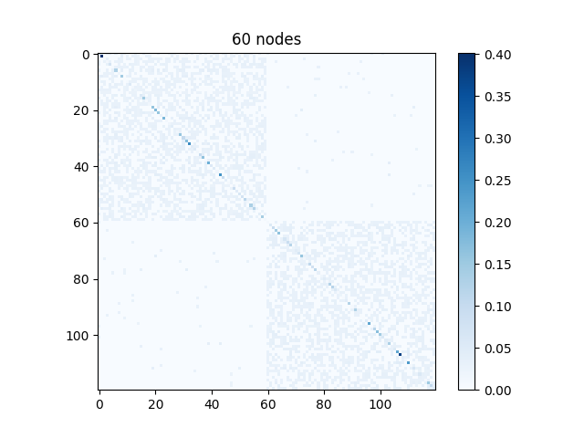
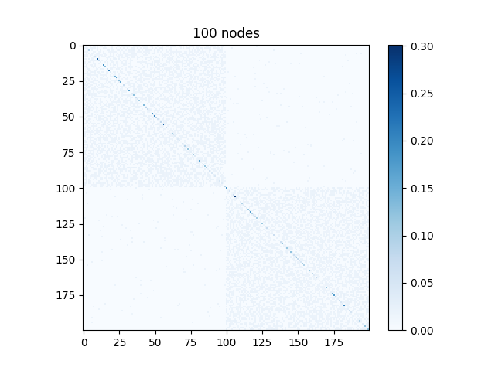
Heatmap of Adjacent Matrix

Slide 9
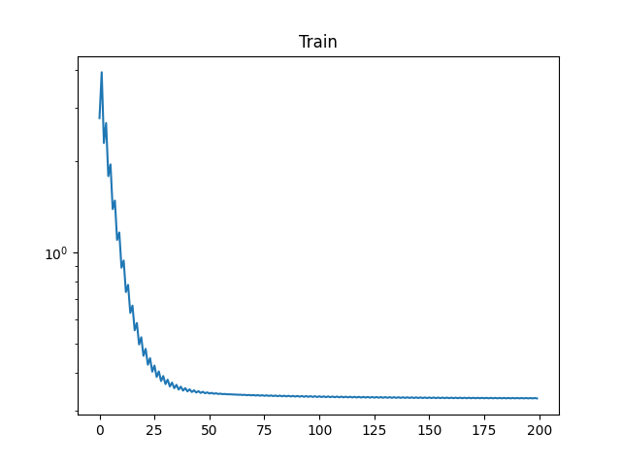
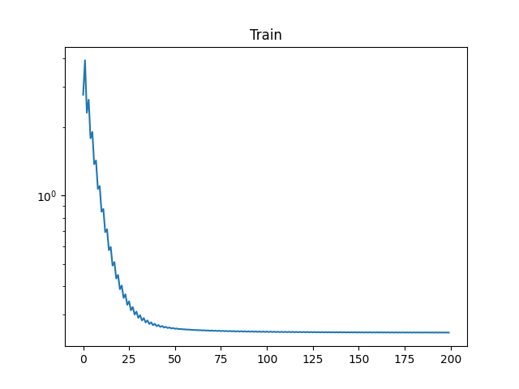
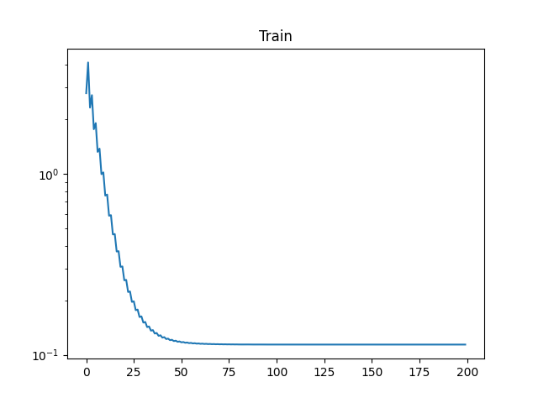
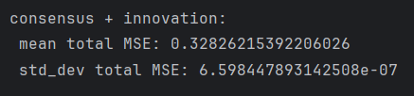


Communicate Prob within the same Block
P_in = 0.4
P_in = 0.5
P_in = 0.9
Global clustering coefficient: 0.37603392173328887
Global clustering coefficient: 0.4767103131874928
Global clustering coefficient: 0.8833679546420546
Density: 0.20241206030150755
Density: 0.2534170854271357
Density: 0.455678391959799

Slide 10

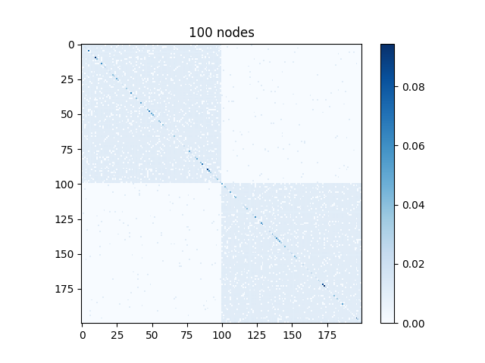
Communicate Prob within the same Block
p_in = 0.4
p_in = 0.5
p_in = 0.9

Slide 11
Compare 10 nodes vs 100 nodes
 | 10 nodes | 100 nodes
Mean (last 100 nodes) | 6.939510775616086e-31 | 0.25008922688759244
Std_dev (last 100 nodes) | 4.437342591868188e-32 | 8.953746215223828e-09
Average Degree | 3.5 | 46
Density | 0.1736842105263158 | 0.2534170854271357
Clustering Coefficient | 0.31833333333333325 | 0.47671031318749263

